Slide 1
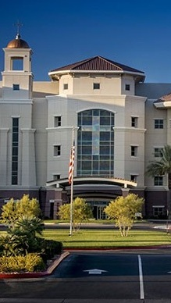


OPPORTUNITY REVIEW
DIRECT-TO-EMPLOYER GTM STRATEGY
Exploring a Dignity Health Nevada DTE Health Plan

Slide 2


Founded in 1979, headquartered in Indianapolis
Largest Independently-Owned Full-Service Third-Party Administrator
Specialize in Administration of Self-Funded Plans and Population Health Management​
Leader in the Direct-to-Employer Movement
We Know and Understand the Market
Experience Working with All Professional Teams: Agents, Networks, MGAs
The Key Family of Companies is a Vertically Integrated group of benefit related organizations
3,000+ Corporate Clients
3 Million Members under Management
700 Employees

Slide 3


MARKET LEADER
IN
PRIVATE LABELED
DTE PLANS
Louisville, KY
OneHealth Plan
Cincinnati, OH
TCH Optimal
Bentonville, AR
Northwest Health Plan
Knoxville, TN
East Tennessee Health Plan
Meridian, MS
Affinity Health Plan
Fort Myers, FL
Lee Health Care Partners

Slide 4
DIGNITY HEALTH IS PATIENT RECOMMENDED
Health System | HCAHPS Recommendation Percentile | CMS Stars Percentile | Mortality Percentile | Readmission Percentile | KBA Brand Quality Score
CommonSpirit Health | 59 | 60 | 66 | 57 | 66
Universal Health Services | 27 | 33 | 69 | 50 | 54
University Medical Center (UMC) of Southern Nevada | 12 | 31 | 71 | 51 | 49
HCA Healthcare | 15 | 37 | 85 | 58 | 48
Prime Healthcare Services | 10 | 10 | 74 | 48 | 47
Based on quality measures and HCAHPS feedback, KBA estimates that Dignity Health has the strongest brand quality in Mohave, and Clark Counties.

Slide 5


DIRECT-TO-EMPLOYER (DTE)
YOU Pick the Name of the Health Plan
YOU Determine the Fees Charged
YOU Practice the Medicine
YOU Receive the Profits
WE Make it Successful
Your Health Plan Focused on a Direct Relationship with Self-Funded Employers in Your Market

Slide 6
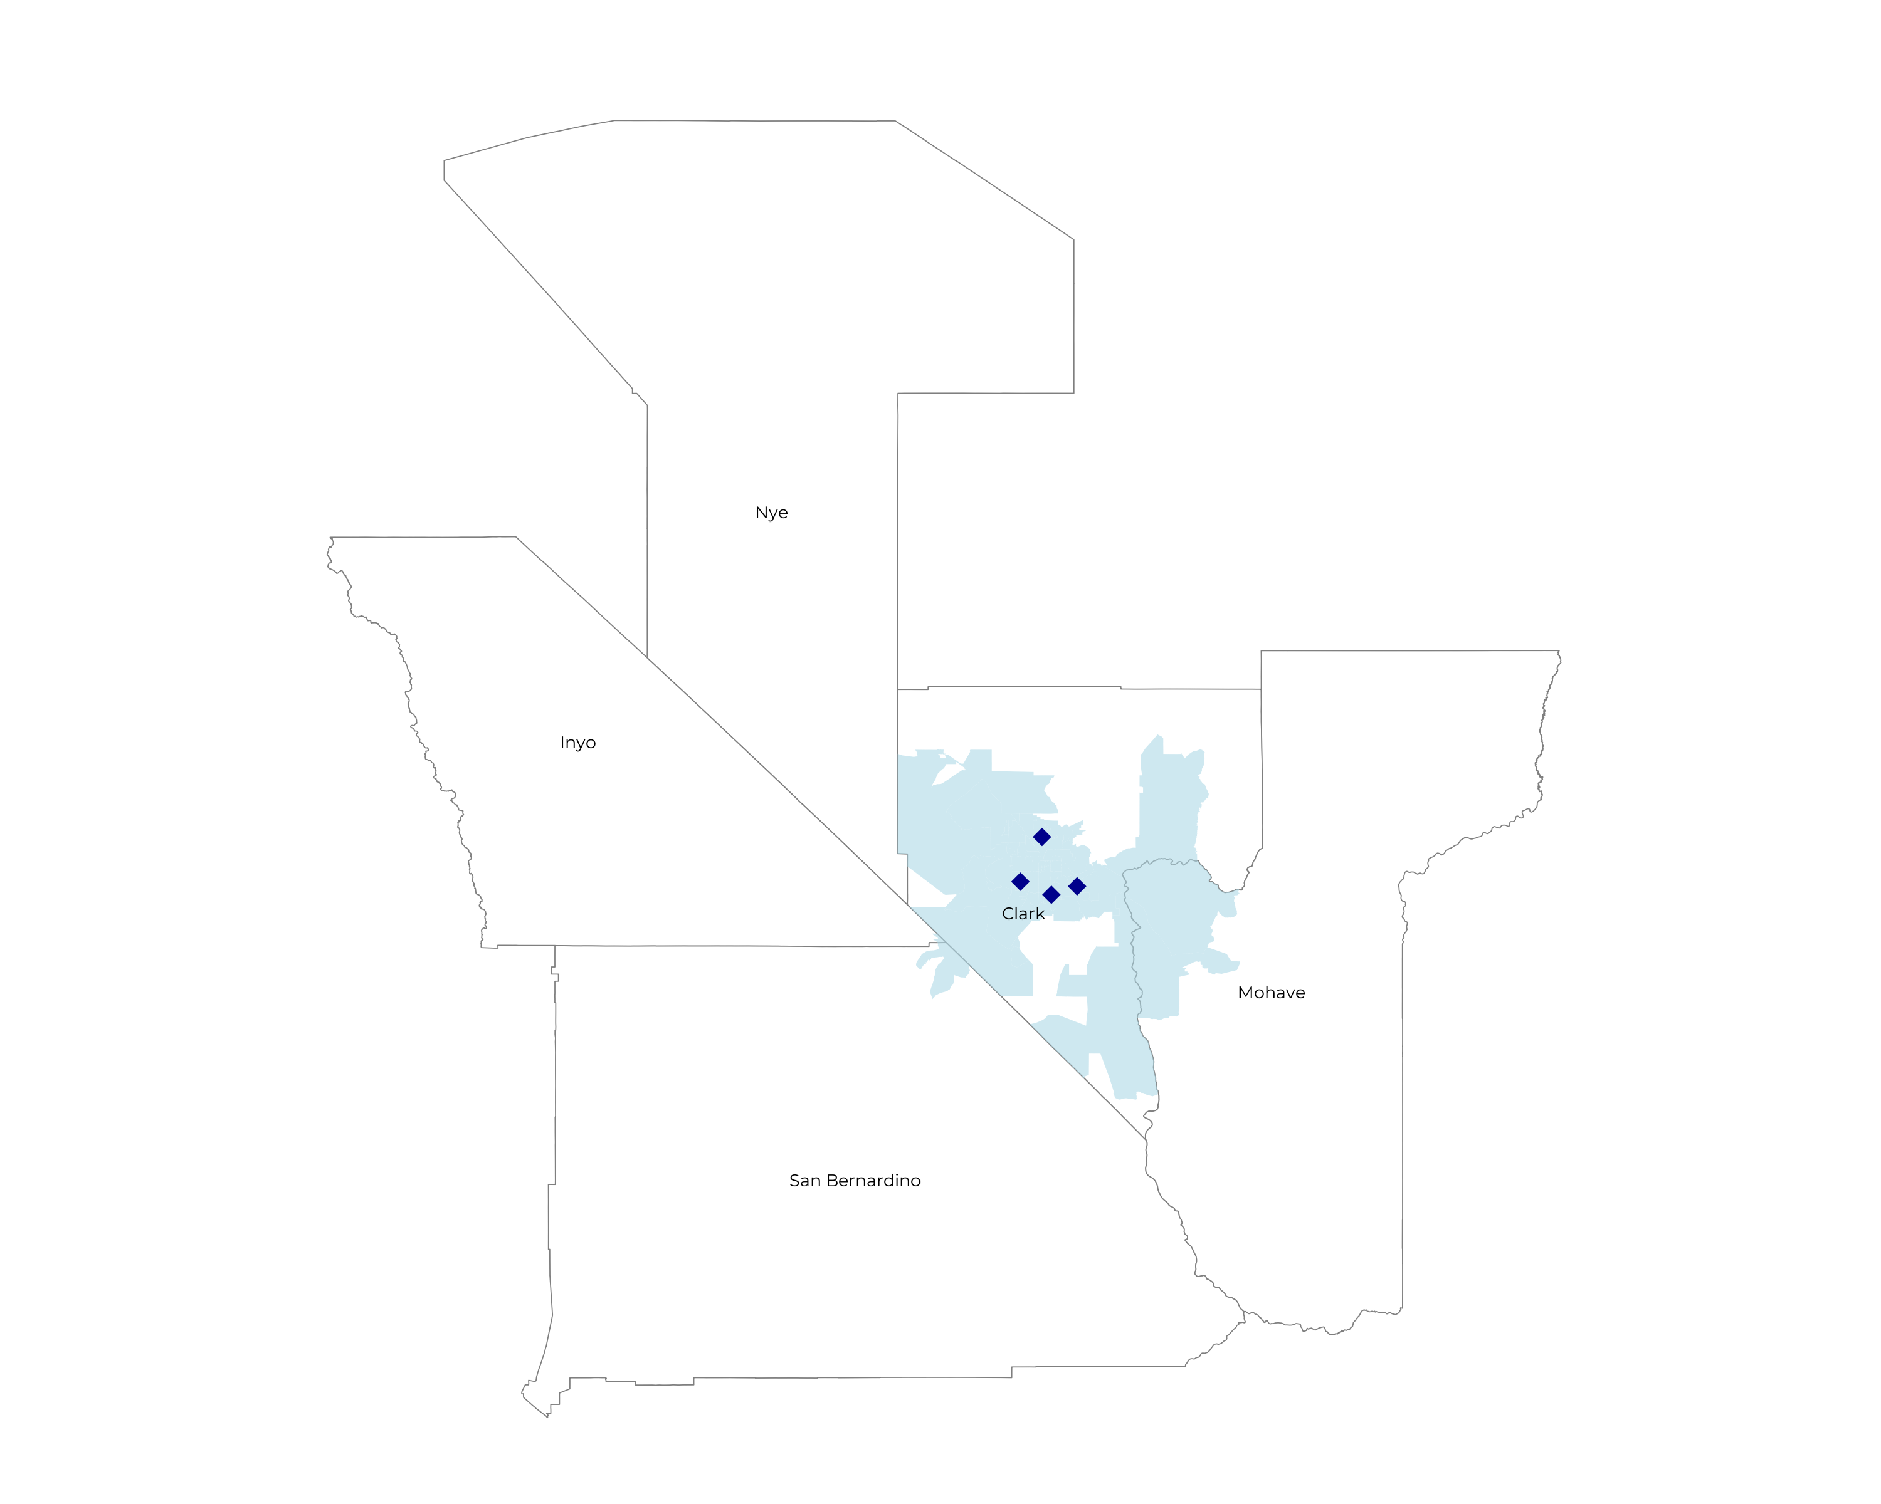
SIGNIFICANT OPPORTUNITY FOR PLAN GROWTH Researched for the below highlighted service area
Target Market 2,500+ Employers 400,000+ Employees 700,000+ Members
 | Employer Size Group (# of Employees)
Commercial Employers With Headquarters | 50-100 | 101-200 | 201-400 | 401-1,000 | 1,001-3,000 | 3,000+
In Catchment Area | 1,443 | 567 | 449 | 211 | 212 | 37
Total Employees at Employers | 50-100 | 101-200 | 201-400 | 401-1,000 | 1,001-3,000 | 3,000+
Headquartered in Catchment Area | 108,200 | 85,100 | 134,700 | 147,700 | 424,000 | 222,000
Total Members with Employers | 50-100 | 101-200 | 201-400 | 401-1,000 | 1,001-3,000 | 3,000+
Headquartered in Catchment Area | 194,800 | 153,200 | 242,500 | 265,900 | 763,200 | 399,600

Slide 7
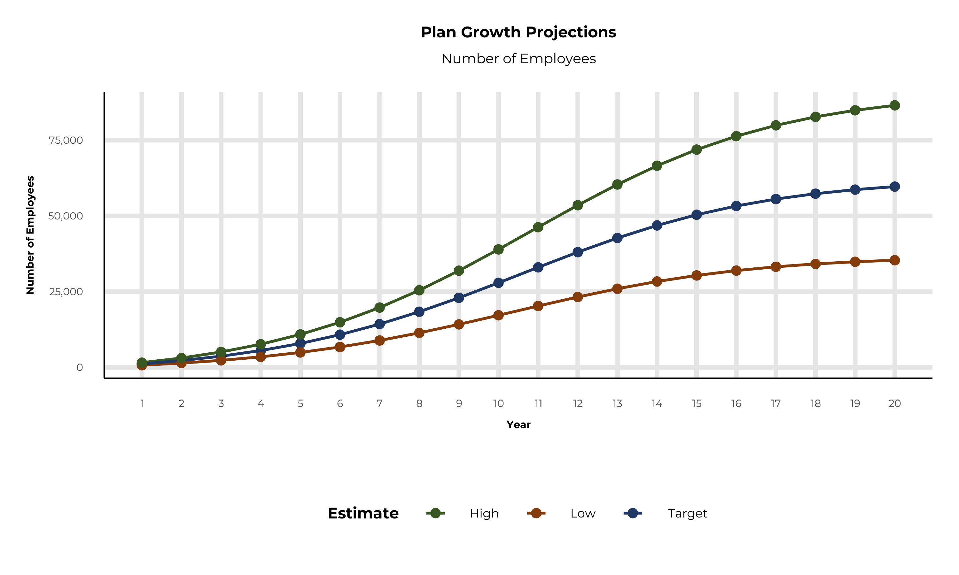
PLAN POTENTIAL GROWTH PATHS
Self Funded
409K
Insured
829K
Working Age
1,314K
Population
2,191K
Estimates includes the Dignity Health Nevada service area in Mohave, and Clark Counties

Slide 8
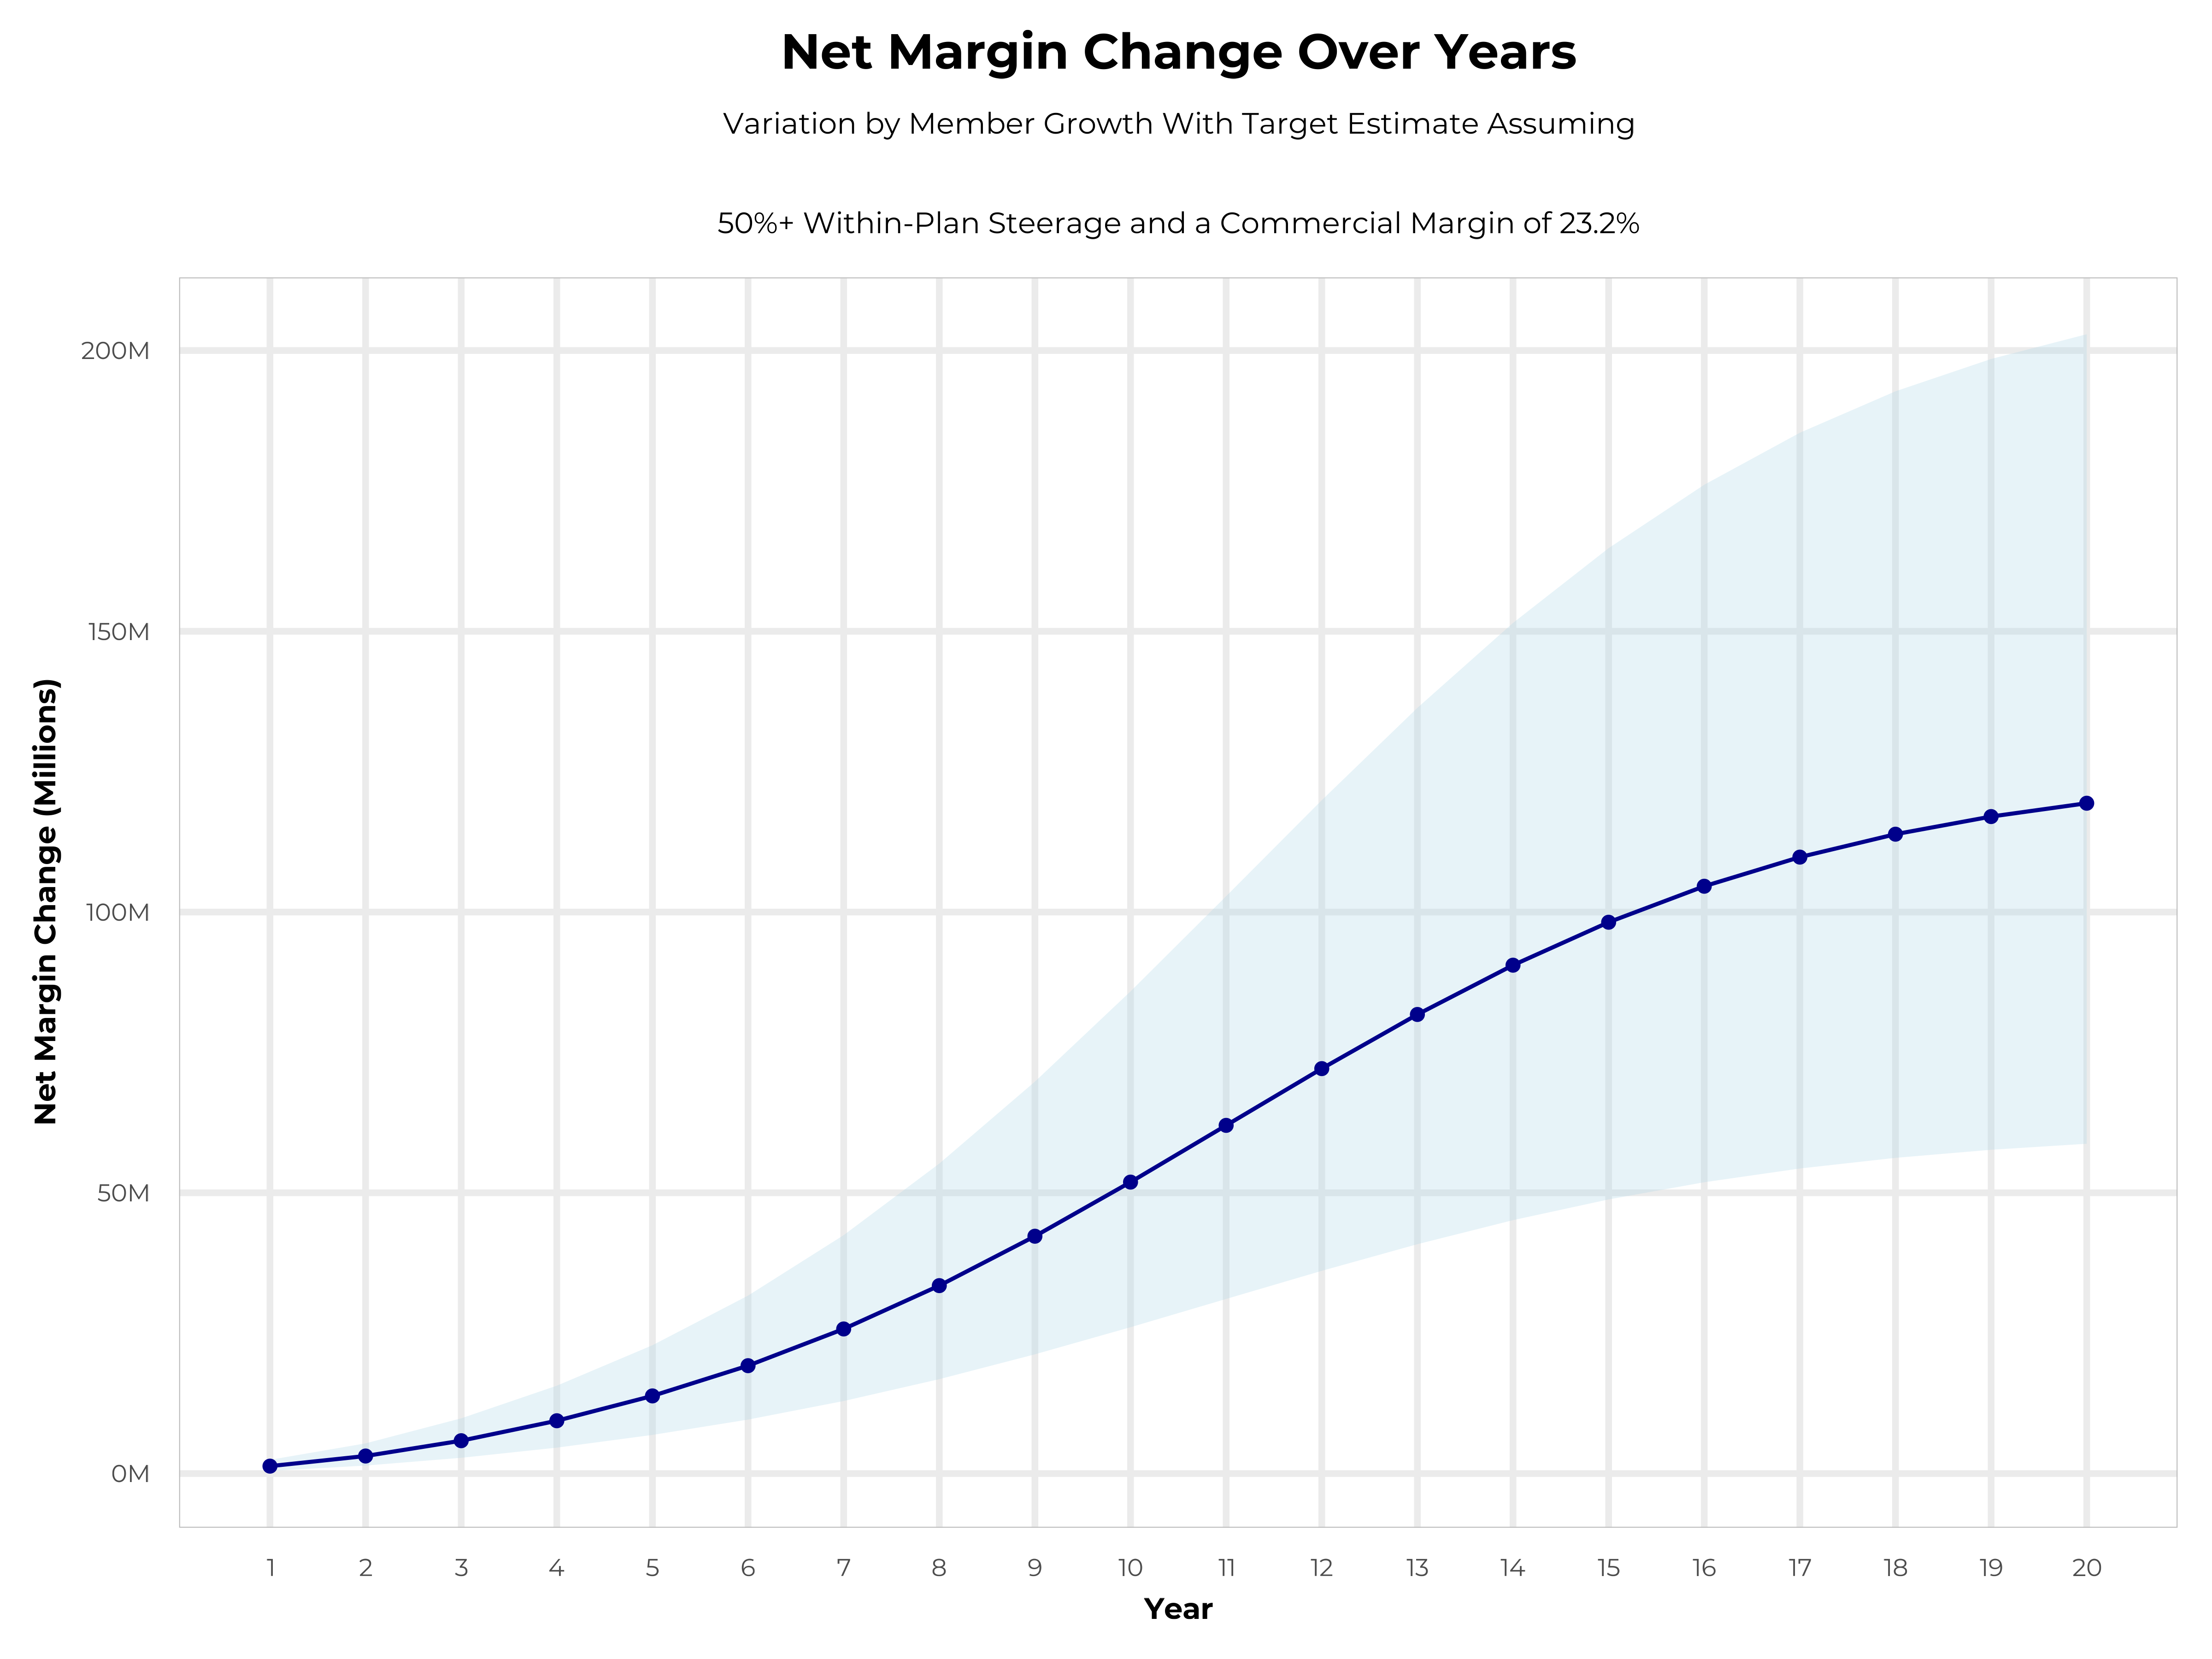
GROWING POWERFUL, LASTING PROFITABILITY
Early Stage
Gaining Name Recognition, Early Growth
New Revenue:
New Profit:
$38.24M
$8.79M
Growth Stage
Strong Reputation, Strong Growth
New Revenue:
New Profit:
$225.25M
$52.75M
Mature Stage
High Profitability, Market Saturation
New Revenue:
New Profit:
$459.01M
$107.62M

Slide 9
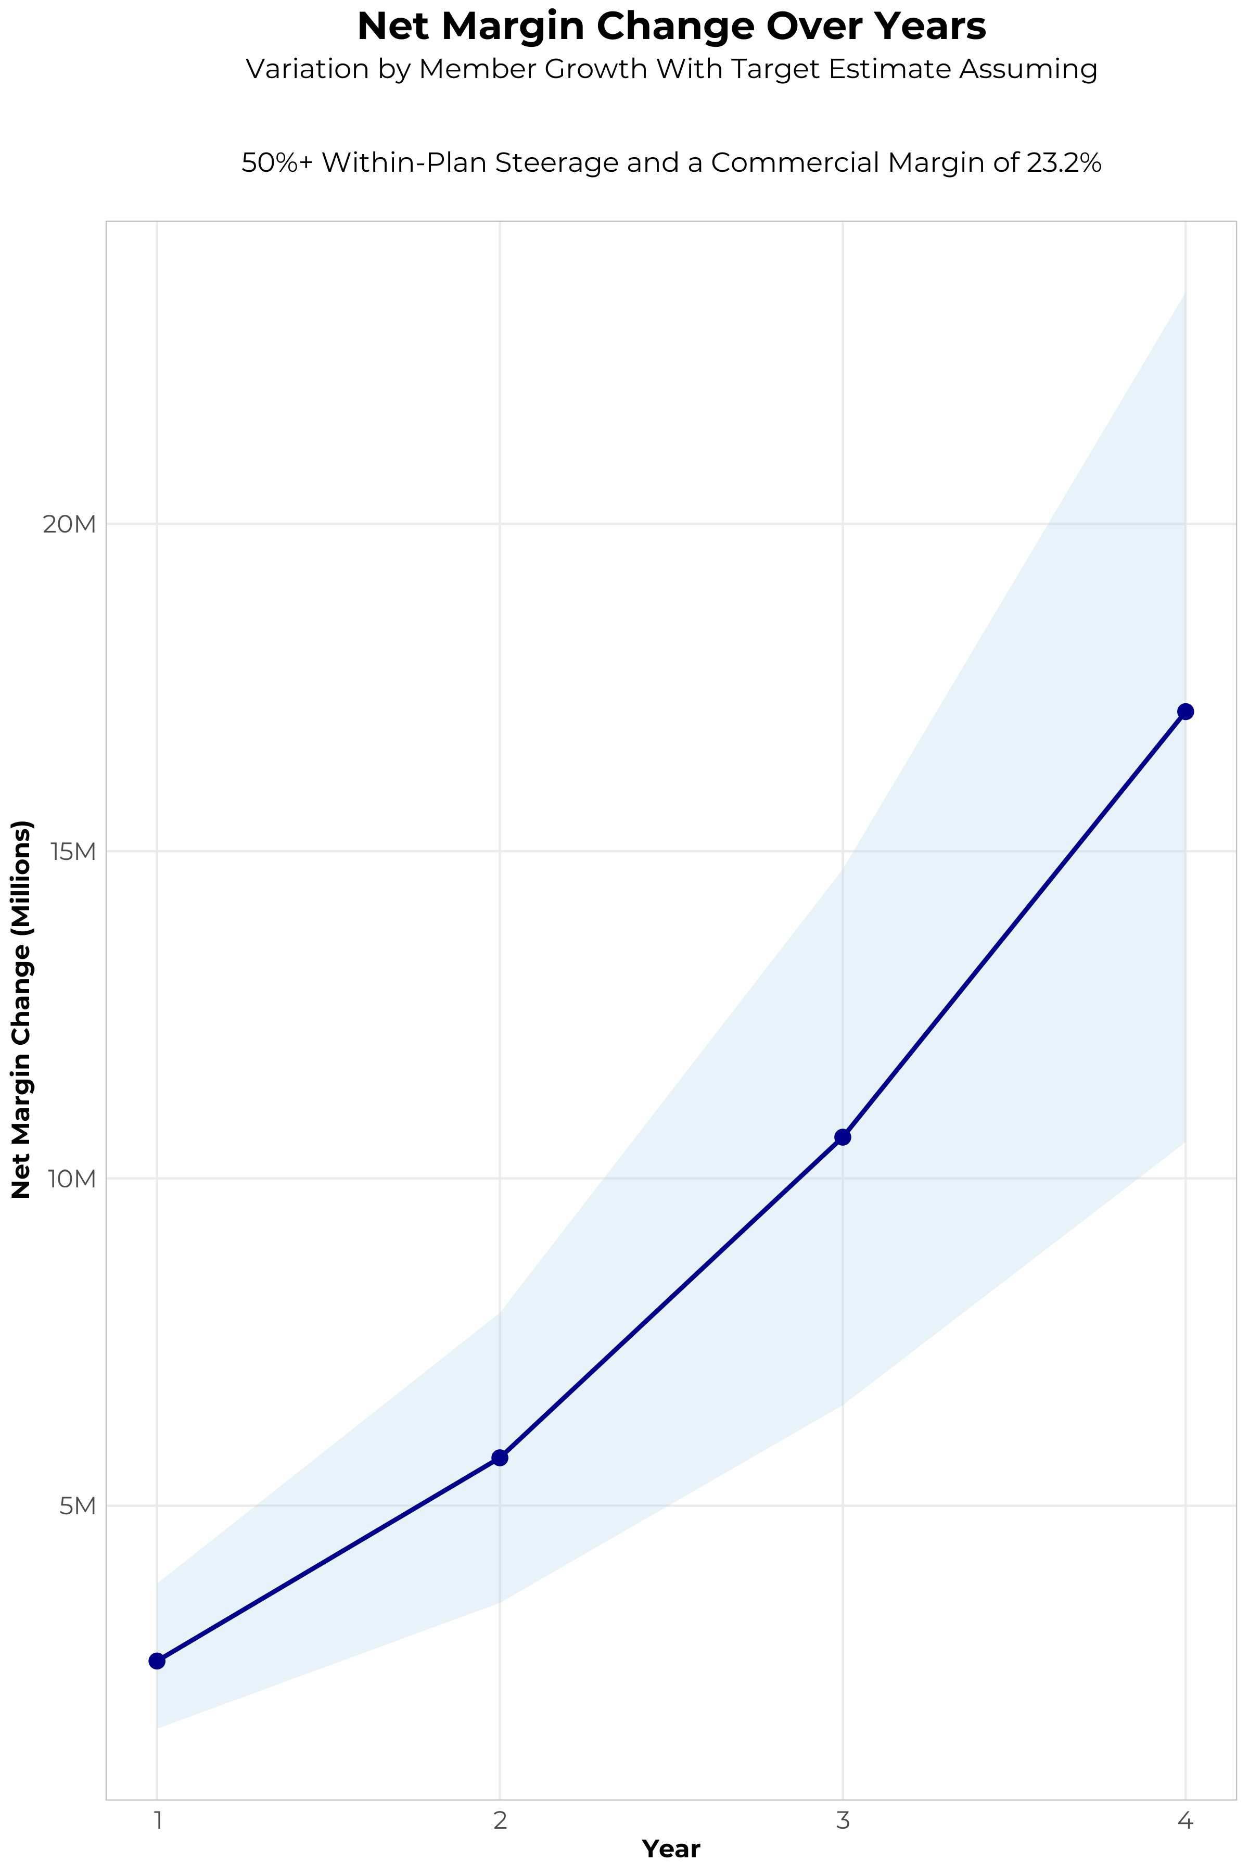
FOUR-YEAR PROJECTIONS
Target Member Growth | Target Member Growth | Target Member Growth | Target Member Growth | Target Member Growth
Metric | Year 1 | Year 2 | Year 3 | Year 4
Number of Members | 2,000 | 4,000 | 6,600 | 10,000
Incremental Margin | 2,931.4K | 5,862.7K | 10,730.6K | 17,192.4K
Network Access Fee | 24.0K | 48.0K | 79.2K | 120.0K
Implementation Fee (One-Time) | -150.0K | 0.0K | 0.0K | 0.0K
Sales and Marketing Costs | -180.0K | -180.0K | -180.0K | -180.0K
Net Margin Change | 2,625.4K | 5,730.7K | 10,629.8K | 17,132.4K
High Member Growth | High Member Growth | High Member Growth | High Member Growth | High Member Growth
Metric | Year 1 | Year 2 | Year 3 | Year 4
Number of Members | 2,800 | 5,500 | 9,100 | 13,700
Incremental Margin | 4,103.9K | 8,061.3K | 14,795.2K | 23,553.6K
Network Access Fee | 33.6K | 66.0K | 109.2K | 164.4K
Implementation Fee (One-Time) | -150.0K | 0.0K | 0.0K | 0.0K
Sales and Marketing Costs | -180.0K | -180.0K | -180.0K | -180.0K
Net Margin Change | 3,807.5K | 7,947.3K | 14,724.4K | 23,538.0K
Low Member Growth | Low Member Growth | Low Member Growth | Low Member Growth | Low Member Growth
Metric | Year 1 | Year 2 | Year 3 | Year 4
Number of Members | 1,300 | 2,500 | 4,100 | 6,200
Incremental Margin | 1,905.4K | 3,664.2K | 6,666.0K | 10,659.3K
Network Access Fee | 15.6K | 30.0K | 49.2K | 74.4K
Implementation Fee (One-Time) | -150.0K | 0.0K | 0.0K | 0.0K
Sales and Marketing Costs | -180.0K | -180.0K | -180.0K | -180.0K
Net Margin Change | 1,591.0K | 3,514.2K | 6,535.2K | 10,553.7K

Slide 10
DIRECT-TO-EMPLOYER STRATEGY: ONLY AVAILABLE TO PREMIER HEALTH SYSTEMS
STRONG Brand Quality
EXTENSIVE Patient Access
AFFORDABLE Value Pricing
EXCELLENT Care Quality

Slide 11
PROJECTED PLAN GROWTH
KBA currently estimates that Dignity Health Nevada has 8% inpatient market share, and 9% outpatient market compared to hospitals/clinics in the Dignity Health Nevada service area (see slide 8).
Based on previous DTE experience, KBA expects a significant bump in patient steerage to Dignity Health Nevada.
Additional steerage will occur from additional steerage patient benefits and the patient card.
High estimates start nearly 10% higher than target with low estimates at 10% lower than target
Year | Employees | Members | Percent of Members Choosing Dignity Health for Inpatient Care | Percent of Members Choosing Dignity Health for Outpatient Care
1 | 1,100 | 2,000 | 60% | 50%
2 | 2,200 | 4,000 | 60% | 50%
3 | 3,700 | 6,700 | 65% | 55%
4 | 5,500 | 9,900 | 67% | 58%
5 | 7,900 | 14,200 | 68% | 60%
6 | 10,800 | 19,400 | 68% | 60%
7 | 14,300 | 25,700 | 69% | 61%
8 | 18,400 | 33,100 | 69% | 62%
9 | 23,000 | 41,400 | 69% | 62%
10 | 27,900 | 50,200 | 70% | 63%
11 | 33,000 | 59,400 | 70% | 63%
12 | 38,000 | 68,400 | 70% | 64%
13 | 42,700 | 76,900 | 71% | 64%
14 | 46,900 | 84,400 | 71% | 65%
15 | 50,400 | 90,700 | 71% | 66%
16 | 53,300 | 95,900 | 72% | 66%
17 | 55,600 | 100,100 | 72% | 66%
18 | 57,300 | 103,100 | 72% | 67%
19 | 58,700 | 105,700 | 72% | 67%
20 | 59,700 | 107,500 | 72% | 67%

Slide 12





A PARTNER YOU CAN TRUST
OUR OBJECTIVES ARE ALIGNED
WE KNOW THE
MARKET
COMPLETELY TRANSPARENT
WE HAVE THE SOPHISTICATION AND INFRASTRUCTURE TO EFFECTIVELY COMPETE
Derek Moore, Senior Vice President – KBA
845-283-9973 * derek.moore@keybenefit.com

